Slide 1
Safety Procedures for Nachi Robot in EZONE Central G.005
Version 1.2
Updated March 2021
Notes:
This a presentation on the safety procedures for the use of the REV (Lab G50 in Electrical Engineering)

Slide 2
Induction
Lab access beyond visitor line requires:
Steel-cap safety shoes
Safety glasses
Operation of Nachi robot requires
Completed Nachi safety induction
Automated robot control only with all people outside the safety fencing.
Notes:
If the task you a performing requires the use of any personal safety equipment ensure that it is used
Such as:
Safety glasses
Ear defenders
Gloves
Closed in footwear to be worn at all times

Slide 3
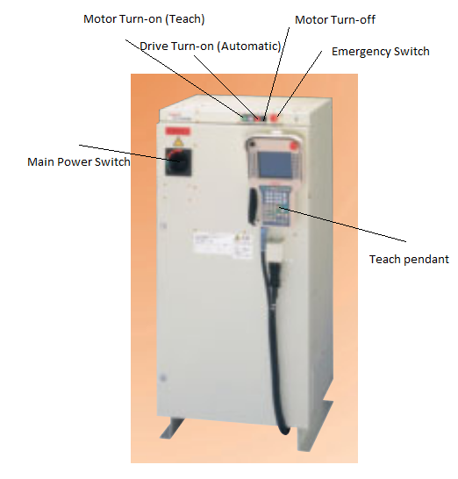
Starting up Robot
Unlock key and remove padlock from robot console
Activate circuit breaker at robot's 3-phase connection
Turn on robot power by rotation switch clockwise
Turn on motors by pressing green button on console
Notes:
If the task you a performing requires the use of any personal safety equipment ensure that it is used
Such as:
Safety glasses
Ear defenders
Gloves
Closed in footwear to be worn at all times

Slide 4
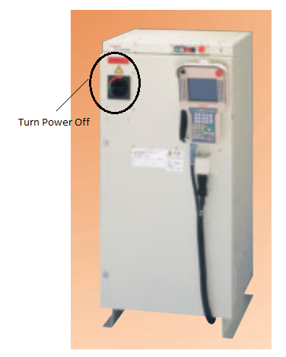
Shutting down Robot
Move robot arm into neutral position using touch-pad
Turn off power by rotating switch on console counter-clockwise
Turn off circuit breaker at power connector
Notes:
If the task you a performing requires the use of any personal safety equipment ensure that it is used
Such as:
Safety glasses
Ear defenders
Gloves
Closed in footwear to be worn at all times

Slide 5
Teach-Pad Operation
Teach-pad operation, e.g. for setting up experiments of storing waypoints can be done when inside the fence:
Move switch to "teach" symbol on robot console and on teach-pad
Lightly press left or right deadman-switch on teach-pad
Use x,y,z buttons to move robot axes
Notes:
If the task you a performing requires the use of any personal safety equipment ensure that it is used
Such as:
Safety glasses
Ear defenders
Gloves
Closed in footwear to be worn at all times

Slide 6
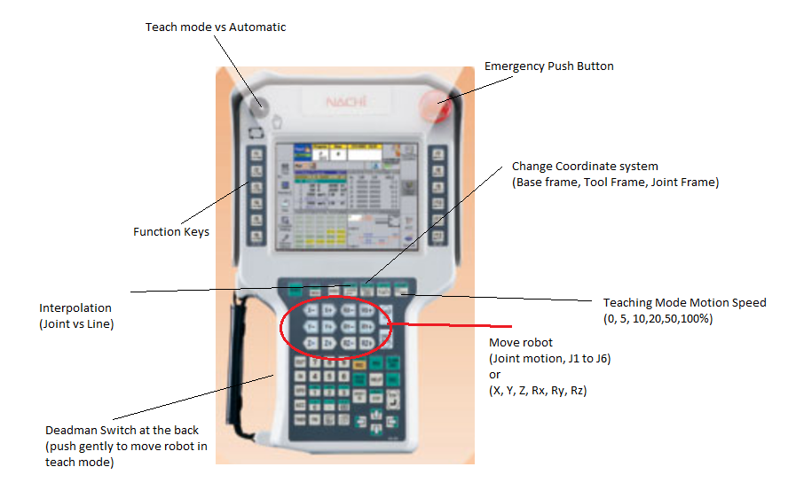
Teach-Pad Operation
Notes:
If the task you a performing requires the use of any personal safety equipment ensure that it is used
Such as:
Safety glasses
Ear defenders
Gloves
Closed in footwear to be worn at all times

Slide 7
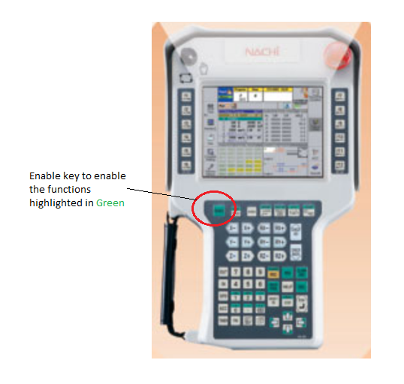
Teach-Pad Operation
Notes:
If the task you a performing requires the use of any personal safety equipment ensure that it is used
Such as:
Safety glasses
Ear defenders
Gloves
Closed in footwear to be worn at all times

Slide 8
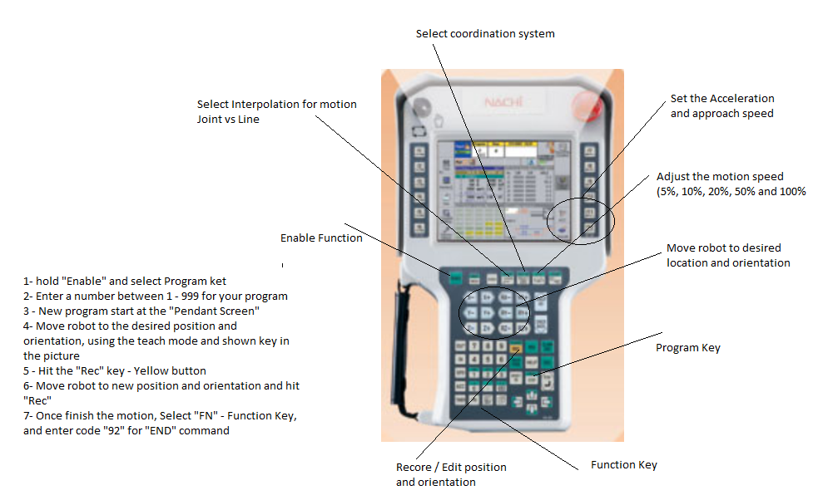
Write a program
Notes:
If the task you a performing requires the use of any personal safety equipment ensure that it is used
Such as:
Safety glasses
Ear defenders
Gloves
Closed in footwear to be worn at all times

Slide 9
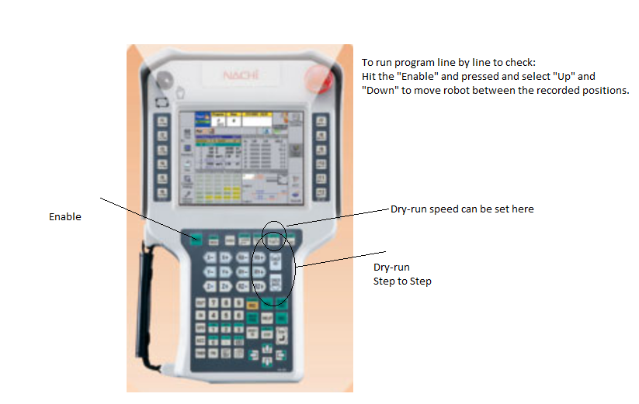
Dry-run (Check) a program
Notes:
If the task you a performing requires the use of any personal safety equipment ensure that it is used
Such as:
Safety glasses
Ear defenders
Gloves
Closed in footwear to be worn at all times

Slide 10
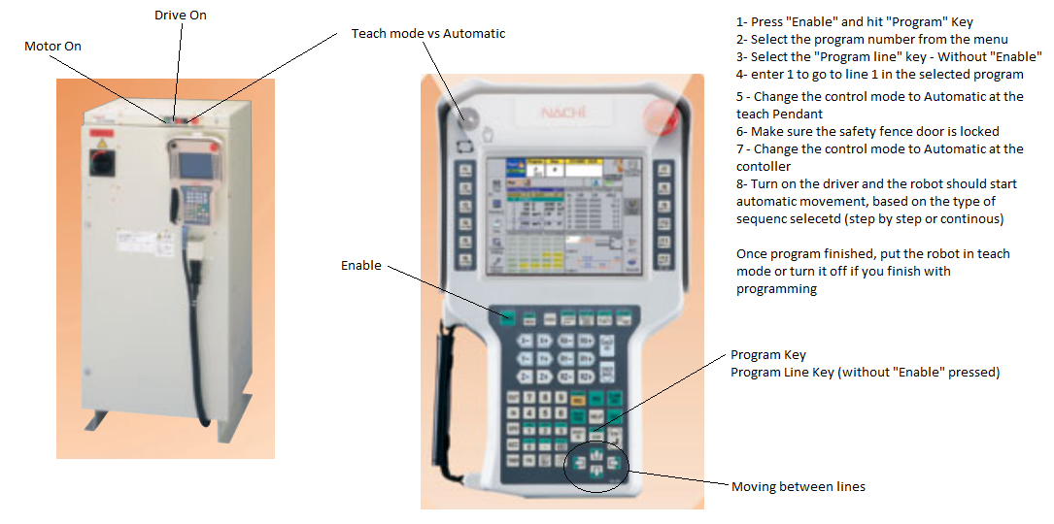
Run a program
Notes:
If the task you a performing requires the use of any personal safety equipment ensure that it is used
Such as:
Safety glasses
Ear defenders
Gloves
Closed in footwear to be worn at all times

Slide 11
Auto-Mode Instructions
On TEACH PAD
Set teach pad & controller to "Manual"
Select GREEN "Enable" + "PROG"
Click: 0 1 <Enter> (Program #1)
Select "STEP"
Click: 0 1 <Enter> (Step #1)
For recording new positions press REC
Repeat this step as necessary
Set teach pad switch to "Automatic"
On CONTROLLER
Set controller to "Automatic"
Press RUN button on controller box
Notes:
If the task you a performing requires the use of any personal safety equipment ensure that it is used
Such as:
Safety glasses
Ear defenders
Gloves
Closed in footwear to be worn at all times

Slide 12
Gate Operation
Gate key in DOWN position and GATE OPEN
to enable teach operation
Gate key in UP (locked) position and GATE CLOSED to enable automatic operation
Notes:
If the task you a performing requires the use of any personal safety equipment ensure that it is used
Such as:
Safety glasses
Ear defenders
Gloves
Closed in footwear to be worn at all times

Slide 13
Automated Operation (1)
Automated operation is only allowed if all persons are outside the fence.
Before running any automated program run it in slow test-mode to make sure the robot arm does not collide with the floor or any objects (it cannot reach the reaction walls or the ceiling)
Notes:
If the task you a performing requires the use of any personal safety equipment ensure that it is used
Such as:
Safety glasses
Ear defenders
Gloves
Closed in footwear to be worn at all times

Slide 14
Automated Operation (2)
Assure nobody is inside the fence
Lock gate switch (or activate light curtain)
Move switch to "automate" symbol on robot console and on teach-pad
Select program to execute on teach-pad
Start program by pushing white start-button on robot console
Always have one person have their hand on the emergency stop button on the teach-pad or the console to immediately stop the robot, if necessary
Notes:
If the task you a performing requires the use of any personal safety equipment ensure that it is used
Such as:
Safety glasses
Ear defenders
Gloves
Closed in footwear to be worn at all times

Slide 15
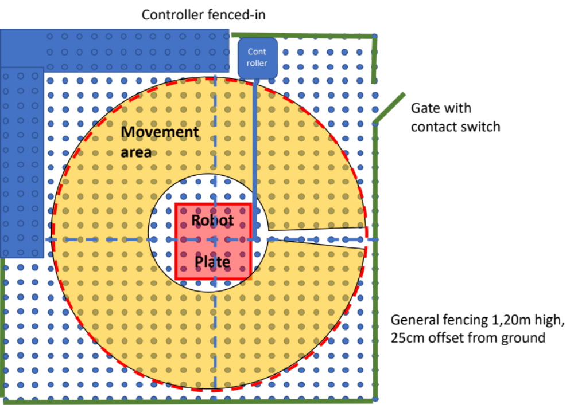
Fencing
Notes:
If the task you a performing requires the use of any personal safety equipment ensure that it is used
Such as:
Safety glasses
Ear defenders
Gloves
Closed in footwear to be worn at all times

Slide 16
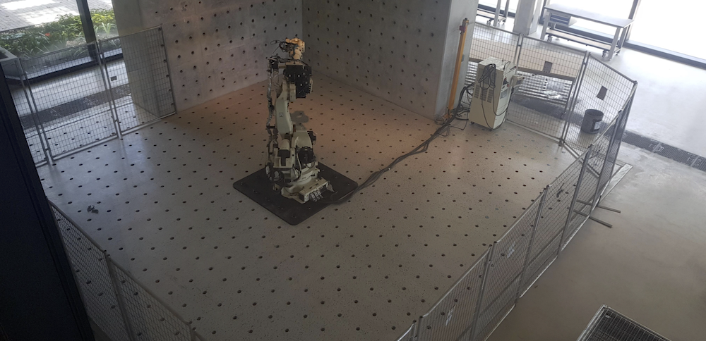
Fencing
Notes:
If the task you a performing requires the use of any personal safety equipment ensure that it is used
Such as:
Safety glasses
Ear defenders
Gloves
Closed in footwear to be worn at all times

Slide 17
Incidents
Never enter the fence when the robot is under automated control
Never activate the robot's automated control when another person is inside the fence area.
If an injury has occurred, call campus security immediately at 6488 2222
later fill in an incident/injury form.
Nearest first-aid team is in EZONE North, ground floor.
Notes:
If the task you a performing requires the use of any personal safety equipment ensure that it is used
Such as:
Safety glasses
Ear defenders
Gloves
Closed in footwear to be worn at all times

